Slide 1
A Brief History of Child Care Activism in Canada

Slide 2
Beginning in 1970, this timeline highlights some key developments in Child Care Activism and the fight across Canada to ensure that child care is accessible and affordable for all.

Slide 3
For each slide, begin by reading the description about each specific event, then watch the video or read through the primary document associated with the slide. Then, complete the questions by typing directly into the PowerPoint.

Slide 4
Throughout the powerpoint, add at least five comments, which may include: your own perspective, questions about the material you have read, or any thoughts about the content.
Type your comments in a small box. This can be done by clicking “Insert” then “Shape”.

Slide 5
1850s – 1940 World War II – 1960 1960 - 1980
READ:
History
in Daycare Kit p. 16-19
Setting the Stage for 1980’s Daycare Activism

Slide 6
Royal Commission on the Status of Women
1970
Tabled in December of 1970, the report included recommendations for reducing gender inequality across Canada. One section addressed daycare, and included recommendations for improving the daycare system across Canada. Specifically, it introduced the concept of the Day Care Act, which has not yet been introduced (as of 2022).

Slide 7
Notes:
Content warning: Please note this video talks about several equality issues, including reproductive rights, homophobia and violence against women.

Slide 8
Questions: Royal Commission on the Status of Women
What year was this video created?
What was the Royal Commission on the Status of Women? Why was it created?
Why is the Royal Commission significant in the history of women’s rights in Canada? Why is it significant in the history of child care in Canada?

Slide 9
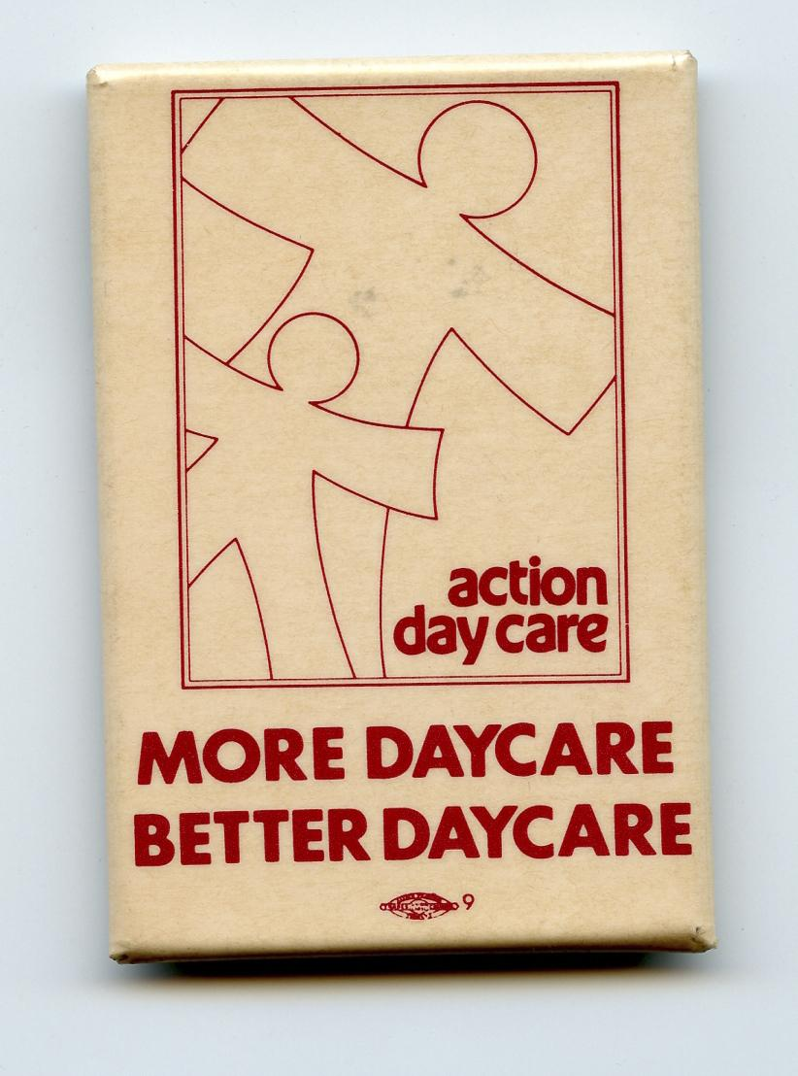
Action Day Care
Action Day Care was created in 1979 by parents, teachers, day care workers, representatives from community organizations, women's organizations and trade unions. As a public advocacy group, Action Day Care united to fight cutbacks, and demanded that day care become a universal service. Action Day Care merged into the Ontario Coalition for Better Child Care and the Canadian Day Care Advocacy Association by the end of the 1980s.
Organization: Action Day Care, An Introduction
1979

Slide 10
Questions: Action Day Care – An Introduction
Which organization published this article? Where are they located?
What is the goal of the organization, as explained in the pamphlet?
What were the specific demands of Action Day Care as listed in the pamphlet?

Slide 11
The 2nd Canadian Conference on Day Care
Sept 22nd – Sept 25th 1982
The Second Canadian Conference on Day Care brought together child care providers, early childhood educators, representatives of social agencies, health and welfare bureaucrats, Indigenous child welfare groups, parents, researchers and advocates. The conference discussions made it clear that much more and much better child care was urgently needed. The important question that emerged was whether day care should be run as a “for profit” or “not-for-profit” service. Upon a vote, 75% supported not-for-profit and 25% thought it should also embrace for profit. This resulted in the creation of two new organizations: The Canadian Day Care Advocacy Association and the Canadian Day Care Federation.
Lisa Pasolli, The evolution of Canada's child care debates

Slide 12
Questions: Second Canadian Conference
In what year did the Conference take place?
What were delegates calling for at the national daycare conference?
Why was the second national conference on daycare significant in the history of child care activism?

Slide 13
1980s
Increase of working mothers with children under 6 years from 17% in 1967 to 48% in 1981
Organized day care activist groups, university campus daycares promoting women’s liberation, baby boomers becoming parents
The State of Day Care 1984 – CBC Archive
Notes:
Report (1993): Employers, Unions and Child Care - https://riseupfeministarchive.ca/activism/organizations/ontario-coalition-for-better-child-care-formerly-ontario-coalition-for-better-day-care/ocbcc-1993-employersunionschild-care-ocr/

Slide 14
Questions: The State of Day Care – CBC Archive
When was the video created?
Why did child care access become a social issue in Canada?
List two issues faced by the families at this time:

Slide 15
Building Up Daycare Advocacy
Union support brings skills and financial support
Second national daycare conference: 1982
Two national daycare organizations
Canadian Day Care Federation (now Canadian Childcare Federation)
Canadian Day Care Advocacy Association (now Child Care Now)

Slide 16
If you have extra time...
International Women's Day (Photo)
Kids Are Not For Profit (button)

Slide 17
Questions: Photos and Button
In what year was the photo taken?
Photo ________ (provide name and year of photo)
Which sign stands out to you? Why?
Can you tell what the organizers’ demands were from the photo?
What does the button suggest to you?

Slide 18
After you have finished...
Change the title of the slideshow to: Your Names- Child Care Activism, and share it with your teacher.

Slide 19
Final Thoughts...
What were the issues that stimulated the expansion of child care demand in the 1980s?
How did parents respond to these events? Were they activists?
What event stands out for you as the most powerful or influential in moving this issue forward?
In your interview with an adult, were the issues the same? Or different?

Slide 20
Teacher Feedback
Criteria | Met | Not Met
Knowledge and Understanding: Knowledge and Understanding of Content The students demonstrate their ability to analyze various primary documents and draw conclusions about their relevance in the grander scheme of daycare activism.
Application: Making connections within and between various contexts The students are able to make connections between the various primary documents and come to a conclusion as to why daycare activism was on the rise.
Thinking: Use of planning skills The students are able to ask questions about the presented material, and make comments on the primary documents presented.
Communication: Expression and organization of ideas in a written form The students are able to respond to questions and articulate their thoughts in a written format
Comments:

